Slide 1
SS Health CARE PROJECT
Kothandarajan Duraiswamy Rajaram​
Dedalus
kduraiswamyr@dedalus.com
9884490339

Slide 2
AGENDA
Introduction​
Environment Setup
Workflow
​Features
​​

Slide 3
Introduction
SS Healthcare Hospital Management Project mainly used to know about the hospital , Medical Services provided in the Site . The list of doctor panel also be listed in this project. Administrator can create new Medical Services and New Doctors using this project.
Main purpose of this project is to showcase or explore the Angular features taught during training period

Slide 4
Environment SETUP

Slide 5
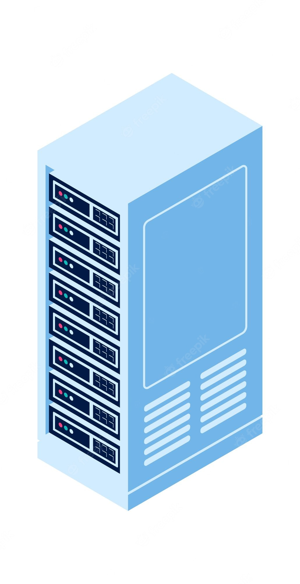
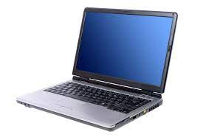

Environment SETUP
Images
Nginx Server
http://localhost:8086/
Data
json-server-auth
json-server-auth --port 4500 data.json
http://localhost:4500/
Output – Browser
http://localhost:4200/
Development Laptop

Slide 6
Workflow

Slide 7
Login
Register user
Admin 0r
User
Admin
User
Admin module
Shared Module
User module
Medical Service
component
Doctor
component
Home Component
Custom Pipe
Custom Directive
Medical Service
component
Doctor
component
Medical Services List
Doctor List
About Hospital
Filter Doctor
Doctor Gender Toggle
Medical Services List
Doctor List
Detail Info of a Medical Service
Filter Doctor
Detail Info of a Medical Service
Filter Doctor
Add New Medical Service
Add New Doctor
Logout

Slide 8
Features

Slide 9




Lazy LOADING
Login is an entry page that requires user identification and authentication, regularly performed by entering a username and password combination.
Lazy loading is a technology of angular that allows you to load JavaScript components when a specific route is activated. It improves application load time speed by splitting the application into many bundles.
Login component decides the login person is administer or user type. Based on the type of user the specific route will be activated.
Admin login
User login

Slide 10
Template Driven Form
A template-driven form is the simplest way to build a form in Angular. It uses Agular's two-way data-binding directive (ngModel) to create and manage the underlying form instance.
Login component and new doctor creation forms are based on template-driven form in this project.
we need to specify behaviors/validations using directives and attributes in our template form .

Slide 11
Model-Driven (Reactive) Form
Reactive forms provide a model-driven approach to handling form inputs whose values change over time.
New Medical Service record creation form is based on Model-Driven (Reactive) form in this project.
Instance of formGroup tracks the status and changes for each of its controls .
Reactive form control provides access to information about a given control through properties and methods and handling input validation in the New Medical service record creation form in this project.

Slide 12
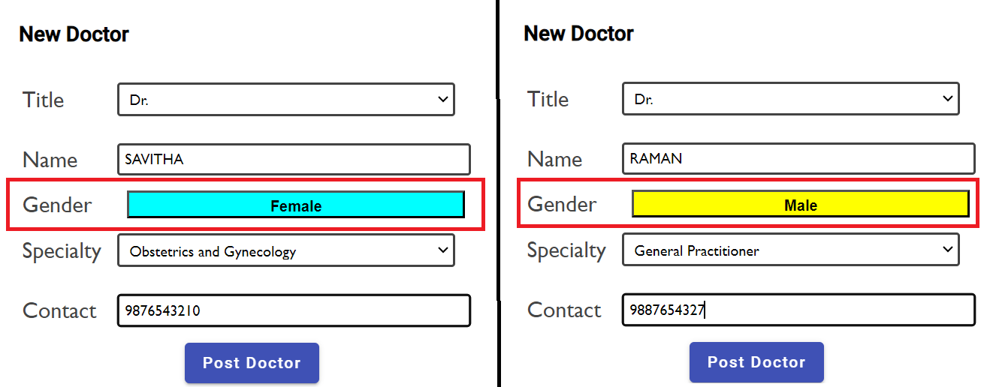
CUSTOM GENDER TOGGLE DIRECTIVE
New custom Gender Toggle directive is created in this project.
This Gender Toggle directive is used in new doctor creation form to select the doctor of new record.

Slide 13
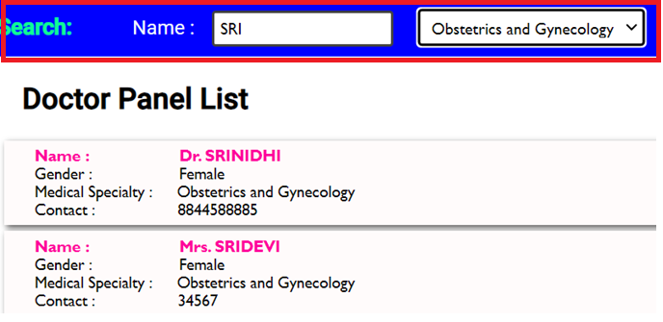
CUSTOM DOCTOR FILTER PIPE
New custom Doctor filter pipe is created in this project.
This custom Doctor filter pipe is used in doctor list to filter based on specialty of the doctor and by entering the doctor's name .
Two parameter pipe is created , one for based on specialty category selected in the combo box and another for the partial name typed over the Name search text box.

Slide 14

Passing Parameters to Route
Route Parameters are a dynamic part of the Route and essential in determining the route.
Route Parameter of medical service id is passed in this project to view the full detail information of medical service selected.

Slide 15
Built IN DIRECTIVES and INPUT VARIABLE
Built in directives and INPUT variable are used in the project to pass the communication between parent and child component and modify the template.
Medical Service boxes are dynamically created using built in directive ngFor
The medical Service detail , New service form , New doctor form etc. are displayed based on ngIf directive.
Built in Uppercase pipe is used to display the Doctor name in capital .
Material Module and Material buttons are used in new doctor and new medical record creation form.

Slide 16
THANK YOU

